Slide 1

SUPPORT VECTOR MACHINES: GENERALIZATION INTUITION
GENERALIZED
MODEL
FEATURE #2
OVERFITTED
MODEL
FEATURE #1

Slide 2
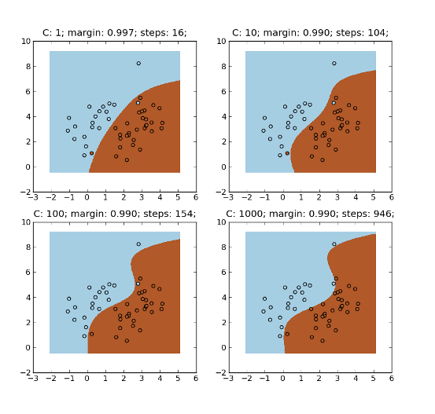
SUPPORT VECTOR MACHINES: PARAMETERS OPTIMIZATION
C parameter: Controls trade-off between classifying training points correctly and having a smooth decision boundary
Small C (loose) makes cost (penalty) of misclassification low (soft margin)
Large C (strict) makes cost of misclassification high (hard margin), forcing the model to explain input data stricter and potentially over fit.
FEATURE #2
FEATURE #1
http://mlpy.sourceforge.net/docs/3.4/svm.html

Slide 3


SUPPORT VECTOR MACHINES: PARAMETERS OPTIMIZATION
Gamma parameter: controls how far the influence of a single training set reaches
Large gamma: close reach (closer data points have high weight)
Small gamma: far reach (more generalized solution)
s$mall γ$
Large $γ$
FEATURE #2
IGNORED!
FEATURE #1

